Slide 1
PETRA veteran cavities.
Unexpected trouble with them
Stefan Wilke, DESY MHF-e
Unexpected trouble with the PETRA veteran cavities
16th ESLS rf meeting
ALBA, Barcelona, 2012-10-09

Slide 2
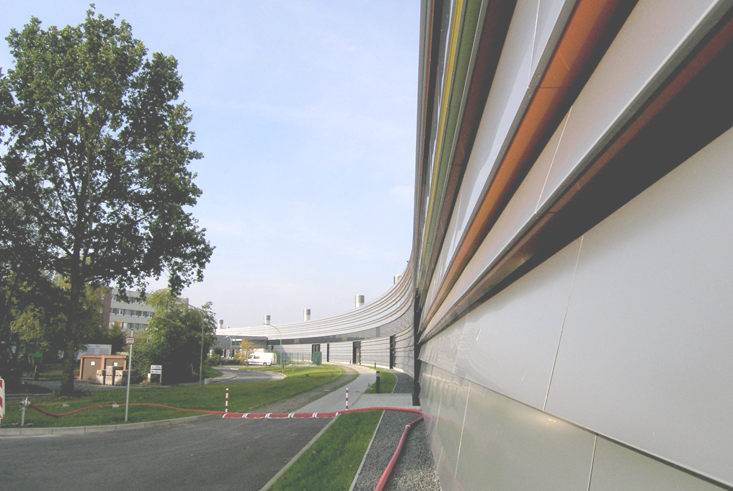
Topics.
Short orientation
7 cell cavity
Coupler protection: Detection of voltage breakdown (spark). $\frac{dr}{dt}$ = $\dot{r}$
Broken quartz glass window
Temperature regulation of each cavity. Temperature-Map
Coupler ceramic turns partly to grey
Doorknob, round – angled
Misunderstood vacuum event and blue light at coupler

Slide 3
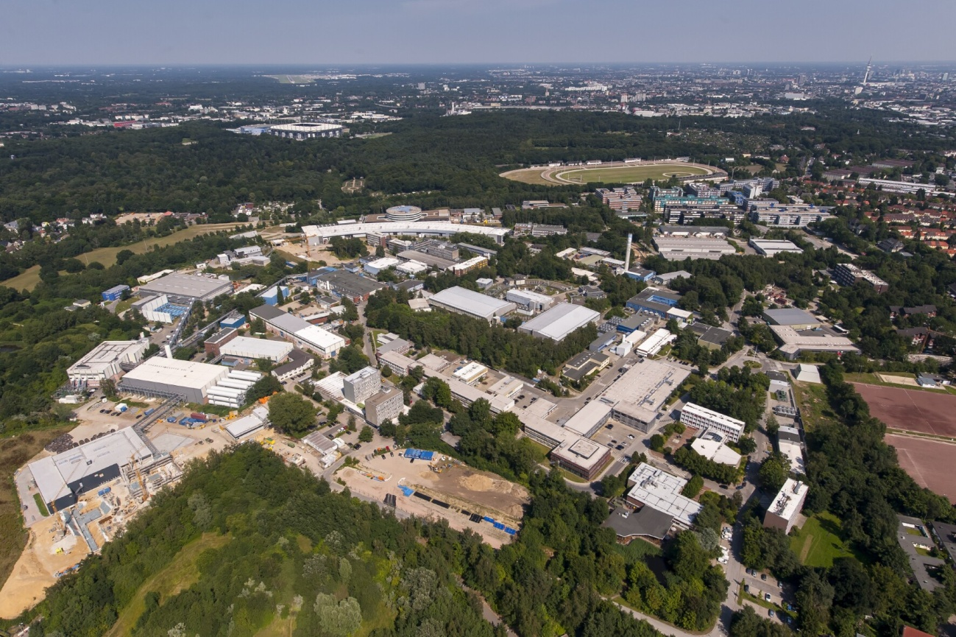
Short orientation.
PETRA: 2304 m, 6 GeV, 100 mA TopUp, 14 undulators (30 beamlines)
Emittance (hor): ε = 1 nmrad ! User operation since 2009
Different fill patterns : 40, 60, 240, 320, 480, (960) bunches
FLASH
DORIS
DESY
20 MV,
12 cavities (7 cell),
ca. 1600 kW required,
4 klystrons,
max. 3200 kW
XFEL
rf section

Slide 4
7 cell cavity, 500 MHz.
For PETRA III we re-installed 12 of the old 16 installed 7-cell cavities.
Mainly because of cost reasons.
Shunt impedance: ca. 23 MOhm
Band width: ca. 54 kHz
Coupler transmission power: ca. 125 kW
Couplers originally designed for 60 kW,
but already operated at DORIS 2 up to 120 kW.

Slide 5
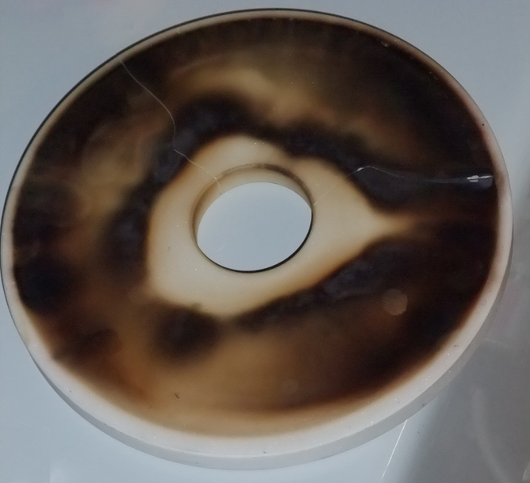
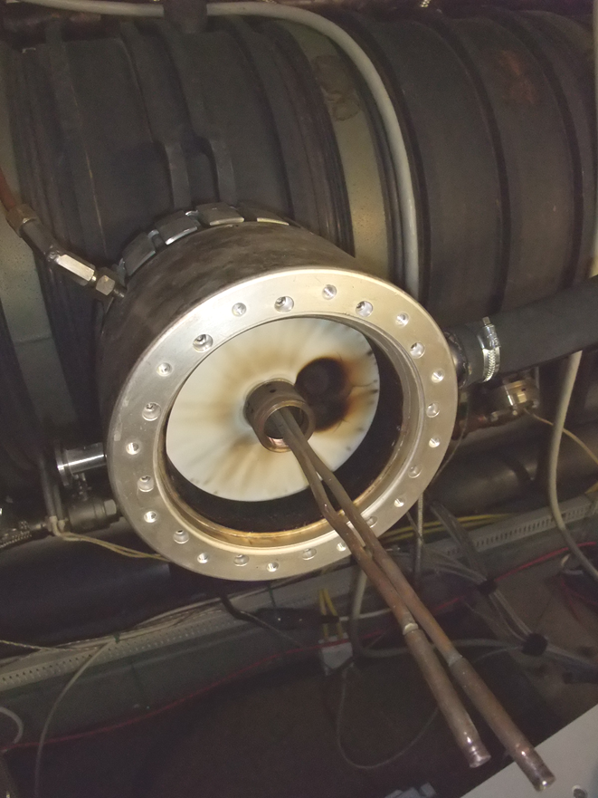
Strong need to protect the couplers.
support ceramic
This happens on 2010-11-10 at SL_Cy4:
An almost broken ceramic.
Only noticed by a very high difference temperature of the cooling air of the coupler.

Slide 6
Sudden voltage breakdown in one cavity.
Watched at different cavities. Here SL_Cy6
Beam
current

Slide 7
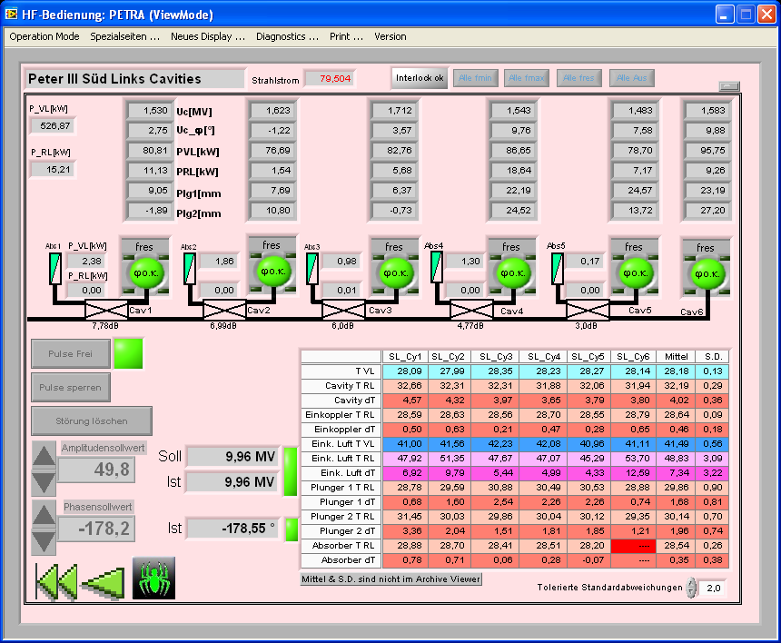
$\dot{r}$.
Detection of sparks
by looking on fast
change of power in
absorbers. This fast
interlock is done by
hardware.
Additionally there are
light sensors.

Slide 8
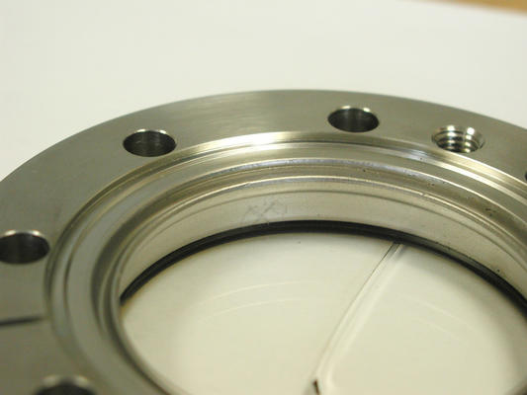
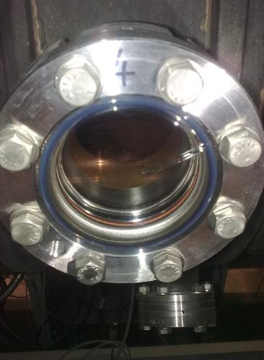
Broken quartz glass window.
2011-05-11 at PE_SR_Cy3
This was never seen before.
Reason unknown.

Slide 9
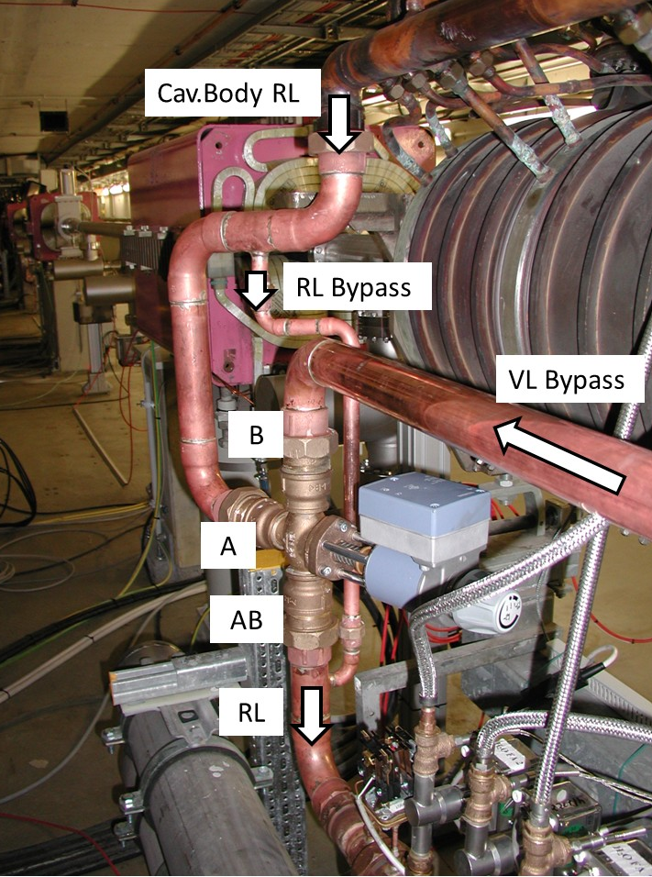
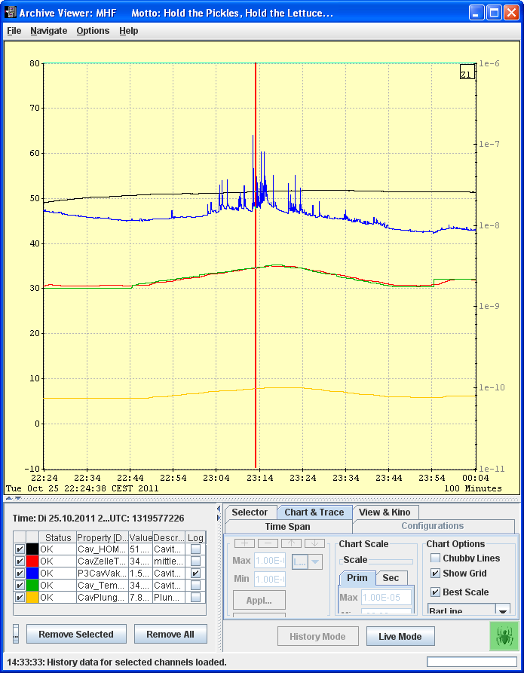
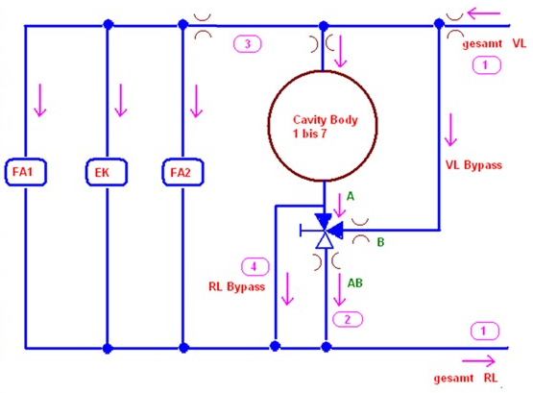
Individually regulation of cavity temperature.
variation: only max. ca. 3 degree
At some cavities very strong relation: temp. - vac.

Slide 10
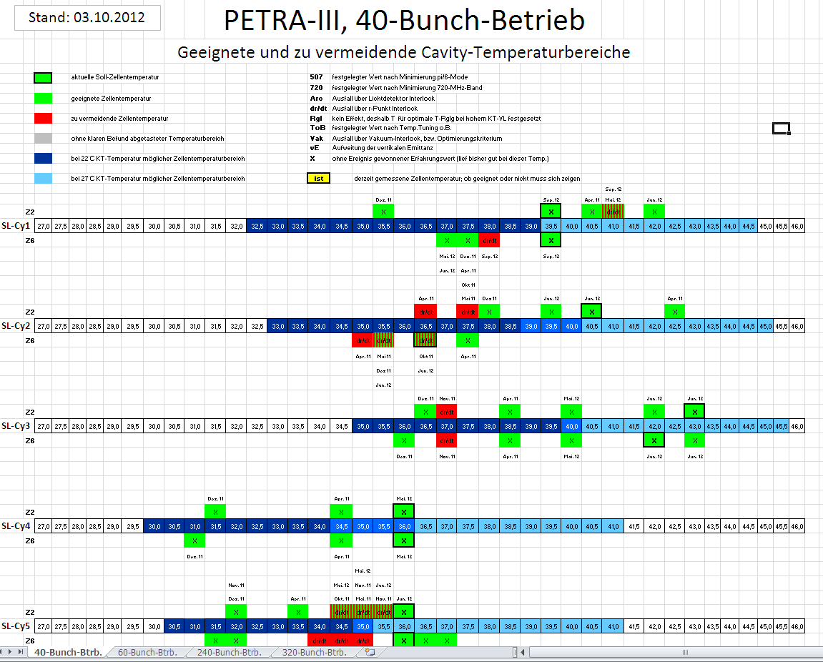
Temperature maps.
The "best"
temperature
for each
cavities is found
empirically.
It depends on
the number of
bunches.

Slide 11
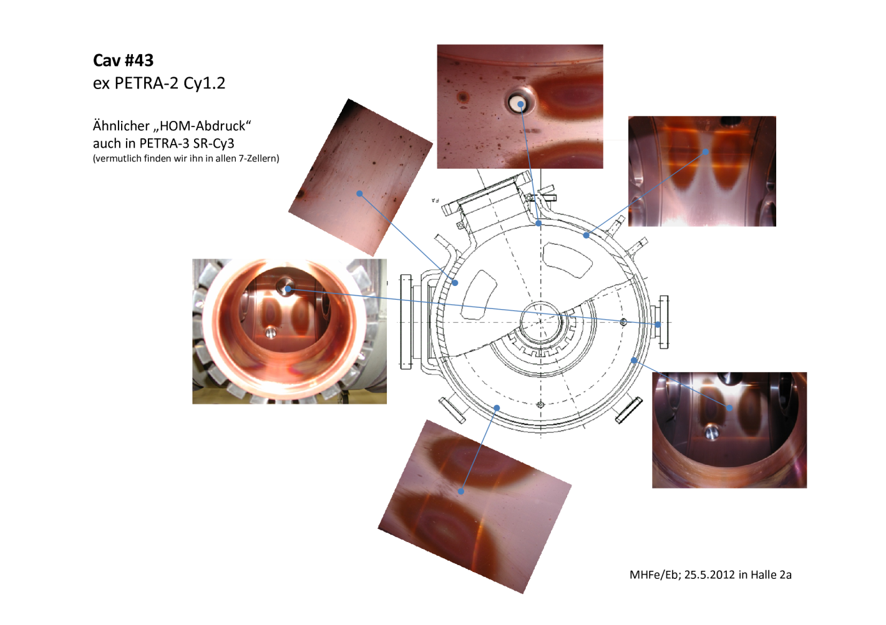
Pictures from inside a cavity taken by an endoscope.
similar marks of
HOMs (?) seen at
SR_Cy3.
Perhaps we can see
that at every cavity

Slide 12
HOMs? painting mystery.
Electric
magnetic
Is this the responsible mode?
We need it two times longitudinally!
f = 1,42 GHz?
pictures from
W. Hillert, Bonn

Slide 13
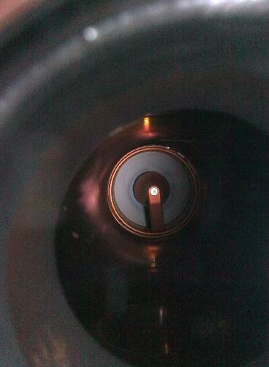
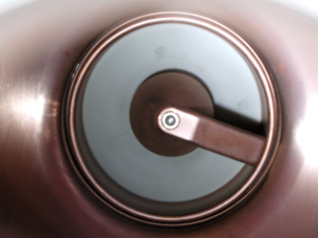
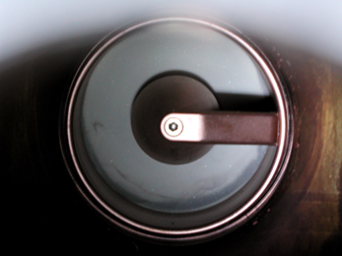
Grey parts on coupler ceramic.
We see this and similar
pattern on some other
cavities. Also observed
at DORIS.
The cavities with that
grey ceramics did NOT
trip more often!
SL_Cy4
SR_Cy2
2010-07-07, SL_Cy2

Slide 14
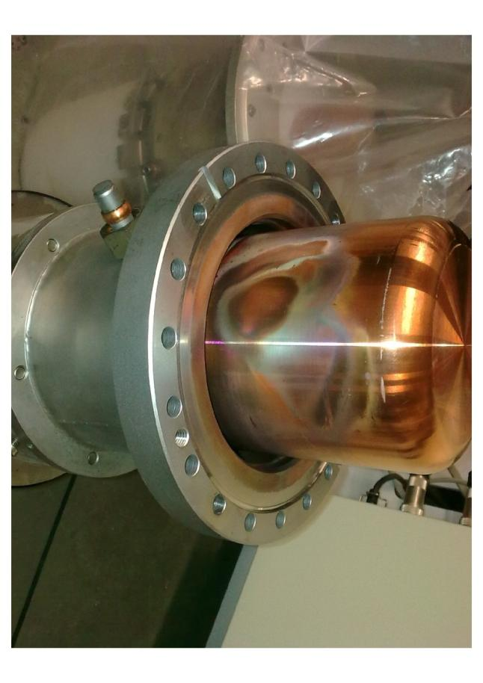
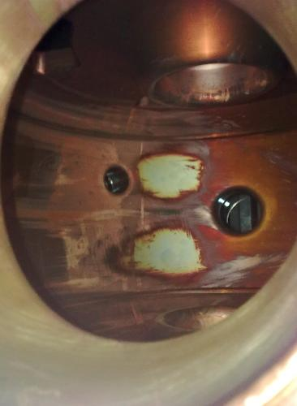
Change of coupler an plungers at SR_Cy3. 2012-04-16.
After many
trips we
changed
the coupler
and the
plungers.
One of them
looks strange.

Slide 15
Better matching with different doorknob.
Test at SR_Cy6:
original: round
return loss: -7 dB
Ceramic window-ΔT with old „round“ doorknob
40 Bu 80mA | 60Bu 100mA | 240Bu 100mA
22,0°C | 21,8°C | 17,4°C
ΔT= -5,5°C
ΔT= -3,1°C
ΔT= -5,1°C
Ceramic window-ΔT with new „angled“ doorknob)
40 Bu 80mA | 60Bu 100mA | 240Bu 100mA
16,5°C | 18,7°C | 12,3°C
recovered: angled, multi steps: return loss: -33 dB

Slide 16
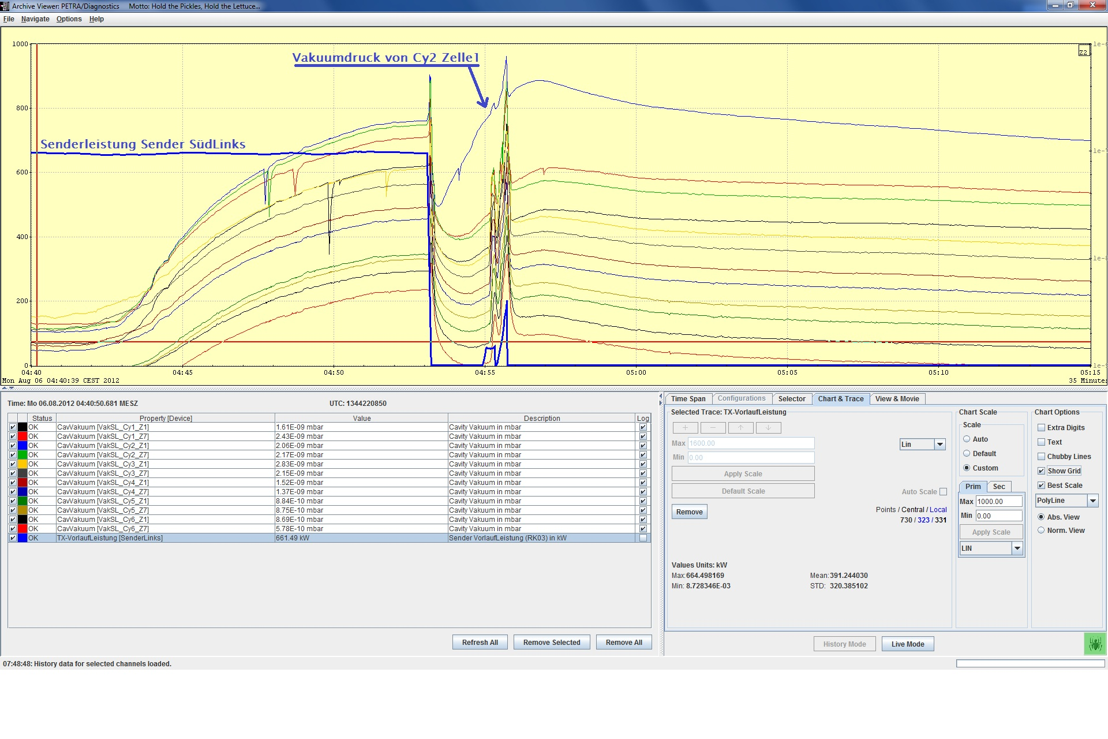
vacuum event.

Slide 17
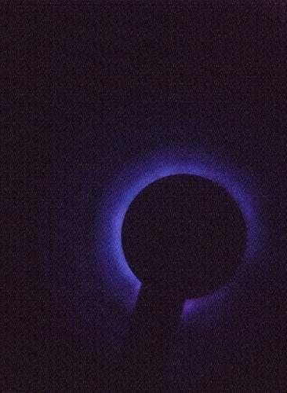
Blue light.
2012-08-06:
at SL_Cy2
starts at ca. 8 kW
but did not expire
up to ca. 35 kW
2011-05-25:
only at cavity SL_Cy4
ca. 30 kW, tuned
light expired at ca. 38 kW

Slide 18
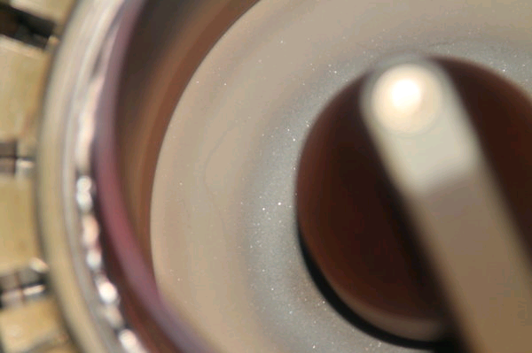
Removed coupler from SL_Cy2.
2012-08-07

Slide 19
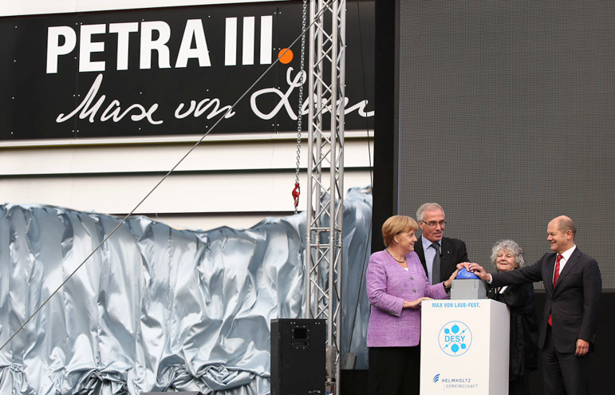
The last one.
Thank you!

